Slide 1

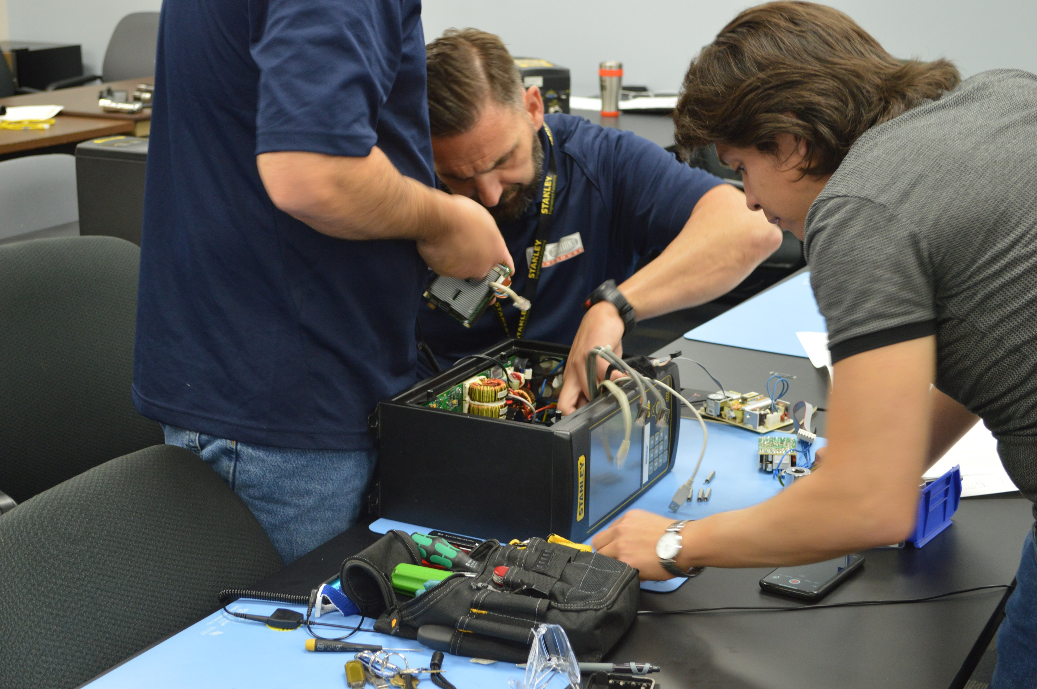

Extended Downtime – The Likely Cost Of Getting It Wrong…
When you purchase service, spares and parts backed by Stanley, you can be sure to avoid unnecessary delays to your production line

Slide 2



Why Buy Stanley Genuine Spares And Parts?
Stanley and our network of service partners are experts on Stanley equipment, repair, and replacement spare parts.
Causes of extended downtime
Delivery delay / Incorrect parts order
Poor fitment of non-manufacturer parts
Poor performance of non-manufacturer parts
When you need your equipment serviced or repaired, you need it now. Avoid the risks and delays of 3rd party dealers or non-Stanley authorized repair service offerings.
Correct Part & Spares.
When you order a replacement or consumable part, you will receive exactly the right part for your equipment model. In addition, if your equipment had any upgrades or rebuilds, our equipment service records will allow us to confirm that new replacement or consumable parts are compatible with the upgraded or rebuilt components.
Lifecycle, Quality & Functionality:
Stanley replacement spares and parts are the original parts and ensure form, fit, and functionality. Our spares and parts are designed to perform with compatibility to our tools and systems. OEM engineering results in parts with an understanding of lifecycle, reliable performance, and repair/replacement cycles. You cannot rely on other vendors to provide the latest version of our parts, part obsolescence, and recommended replacements.
Warranty & Support
Our replacement spares and parts come with warranties and Stanley / Stanley Certified Repair Center post-sale support and services. This team of parts experts who will help guide you through the selection, purchasing, and post-sale support processes. If your purchase requires specialized technical information, our Stanley repair and service team offers extensive knowledge and support. In addition, parts-related services including operational assessments, preventive maintenance, calibration and field services that help you avoid problems before they become emergencies. On occasion, more is needed than just a spare part and that is when the advantage of purchasing your parts directly from Stanley becomes clear.
Looking for your Stanley Service and Support Network: Go to www.StanleyEngineeredFastening.com > Support > Find A Distributor
Stanley Backed Benefits Accuracy: Assurance that the correct part needed is provided Downtime Avoidance: Replacement spare part fit, functionality, and performance based on build of tool Service Backed Purchases: Additional value-added services and support based on the experts at Stanley Coverage: Stanley spares and parts are supplied with warranty coverage With Stanley, be confident you are covered
Stanley Service Network When you purchase Stanley products, you are gaining access to our network of support, something you will lack with non-Stanley parts or unauthorized dealers and distributors. The Stanley network ensure you can get questions answered by someone who knows the tools equipment and the parts firsthand. With unauthorized dealers and distributors, there is a lack of expertise and access to information on the replacement spare parts, tools, equipment, and supporting services.
For more information, contact us at: SATInfo@sbdinc.com
Local Contact
©2020 Stanley Engineered Fastening. All Rights Reserved. 10.20

